Slide 1
Math 769: Statistical Learning

Slide 2
Linear Regression Assumptions
Shahrzad Jamshidi, PhD

Slide 3
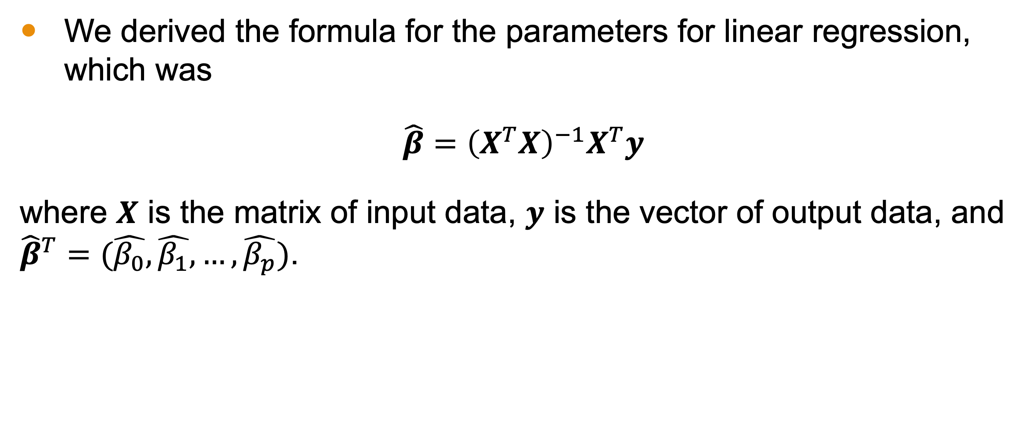
Last Time
We derived the formula for the parameters for linear regression, which was
$\hat{β}={\left(X^{T}X\right)}^{−1}X^{T}y$
where $X$ is the matrix of input data, $y$ is the vector of output data, and ${\hat{β}}^{T}=(\hat{β_{0}}, \hat{β_{1}}, …,\hat{β_{p}})$.

Slide 4
Objectives for this Lesson
List all the assumptions required for linear regression.
Define the residual.

Slide 5
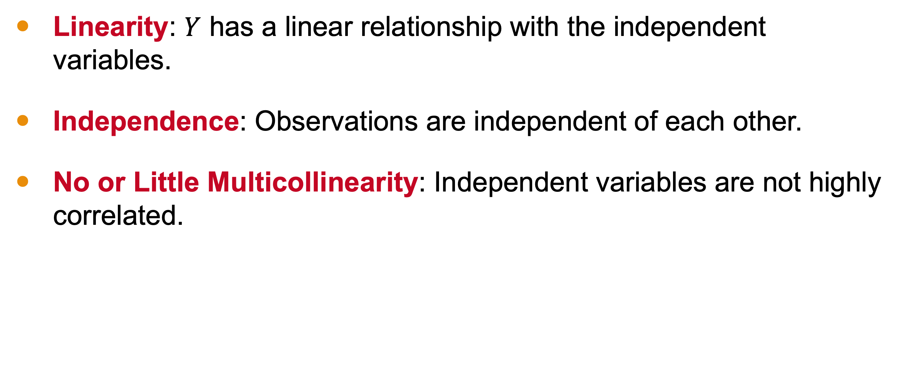
3 Assumptions of Linear Regression
Linearity: $Y$ has a linear relationship with the independent variables.
Independence: Observations are independent of each other.
No or Little Multicollinearity: Independent variables are not highly correlated.

Slide 6
What is independence?

Slide 7
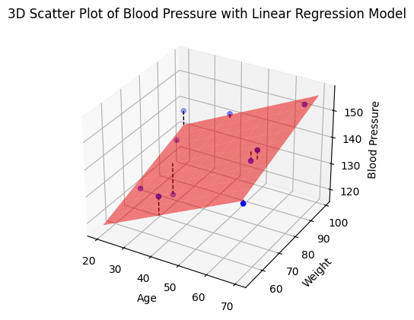
Estimating Blood Pressure
Age | Weight | BP
64 | 72 | 149
67 | 96 | 154
20 | 99 | 137
23 | 70 | 124
23 | 90 | 131
59 | 77 | 141
29 | 79 | 118
39 | 97 | 142
41 | 54 | 136
70 | 54 | 142
Notes:
When observations are said to be "independent" in the context of statistical analysis or data modeling, it means that the values or measurements taken on one observation do not have any influence or impact on the values or measurements taken on other observations.
In this hypothetical situation, that makes sense since each row represents a person. One person’s age, weight, and blood pressure should be independent of another person’s.

Slide 8

Without Independence
The irreducible error, $ε$, will not be $N(0, σ^{2})$.
Statistical validity of tests will be compromised.
Model interpretation and predictive accuracy will be undermined.

Slide 9
What does multicollinearity mean?

Slide 10
Estimating Blood Pressure
Age | Weight | BP
64 | 72 | 149
67 | 96 | 154
20 | 99 | 137
23 | 70 | 124
23 | 90 | 131
59 | 77 | 141
29 | 79 | 118
39 | 97 | 142
41 | 54 | 136
70 | 54 | 142
Notes:
When a set of observations exhibits little to no multicollinearity, it means that the independent variables (features) used in a statistical or regression model are not strongly correlated with each other. In other words, there is minimal or no linear relationship between the independent variables.
In this hypothetical situation, we’d probably want to specify that these are adults to ensure that age does not heavily influence weight. Still, we should expect some collinearity within this example, which could influence the quality of our model.

Slide 11
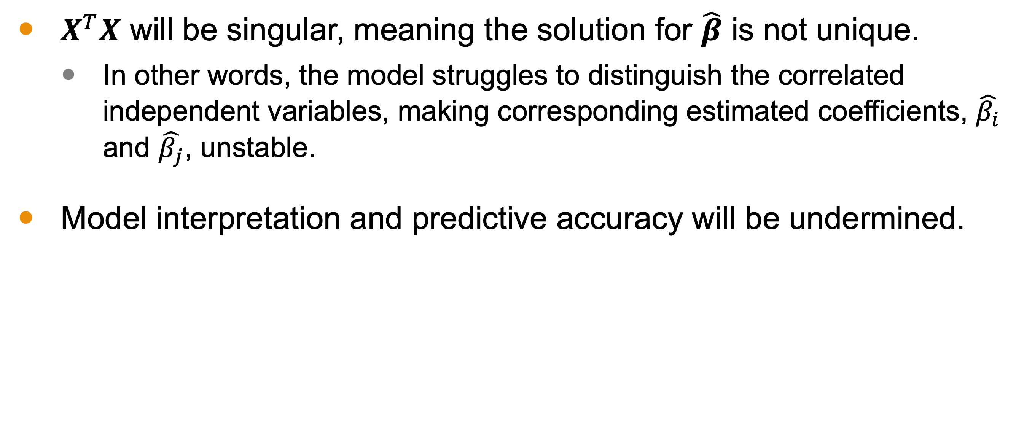
Multicolinearity
$X^{T}X$ will be singular, meaning the solution for $\hat{β}$ is not unique.
In other words, the model struggles to distinguish the correlated independent variables, making corresponding estimated coefficients, $\hat{β_{i}}$ and $\hat{β_{j}}$, unstable.
Model interpretation and predictive accuracy will be undermined.

Slide 12
Residuals
There are two additional assumptions related to the residuals, the difference between the observed and estimated dependent variable values.
The residuals here are represented by the length of the dashed lines

Slide 13

Two More Assumptions
Homoscedasticity: The variance of the residuals is constant, $σ^{2}$.
Note that this is the same $σ^{2}$ from the variance of the irreducible error.
A consequence of this assumption is $Var\left(y | X\right)=σ^{2}I_{N×N}$
Normality: The residuals are normally distributed with mean 0.
Notes:
Homoscedasticity is the assumption that the variance of the residuals is constant across all levels of the independent variable(s). We often inspect this visually by checking that the data points are evenly scattered around the regression line, plane, or hyperplane with consistent spread. In our example, there simply aren’t enough datapoints to get a clear picture of this.
Normality pertains to the distribution of the residuals, which is not the same as checking their variance. Instead, we’re looking to see

Slide 14
Last Two Assumptions Visually
Homoscedasticity means the points are spread “at approximately constant width” around the surface.
Normality means points are “evenly distributed” around the surface with no skew toward one side or another in regions.

Slide 15
Why These Assumptions?
In the next video, we will use these assumptions to derive important statistics for linear regression.

Slide 16
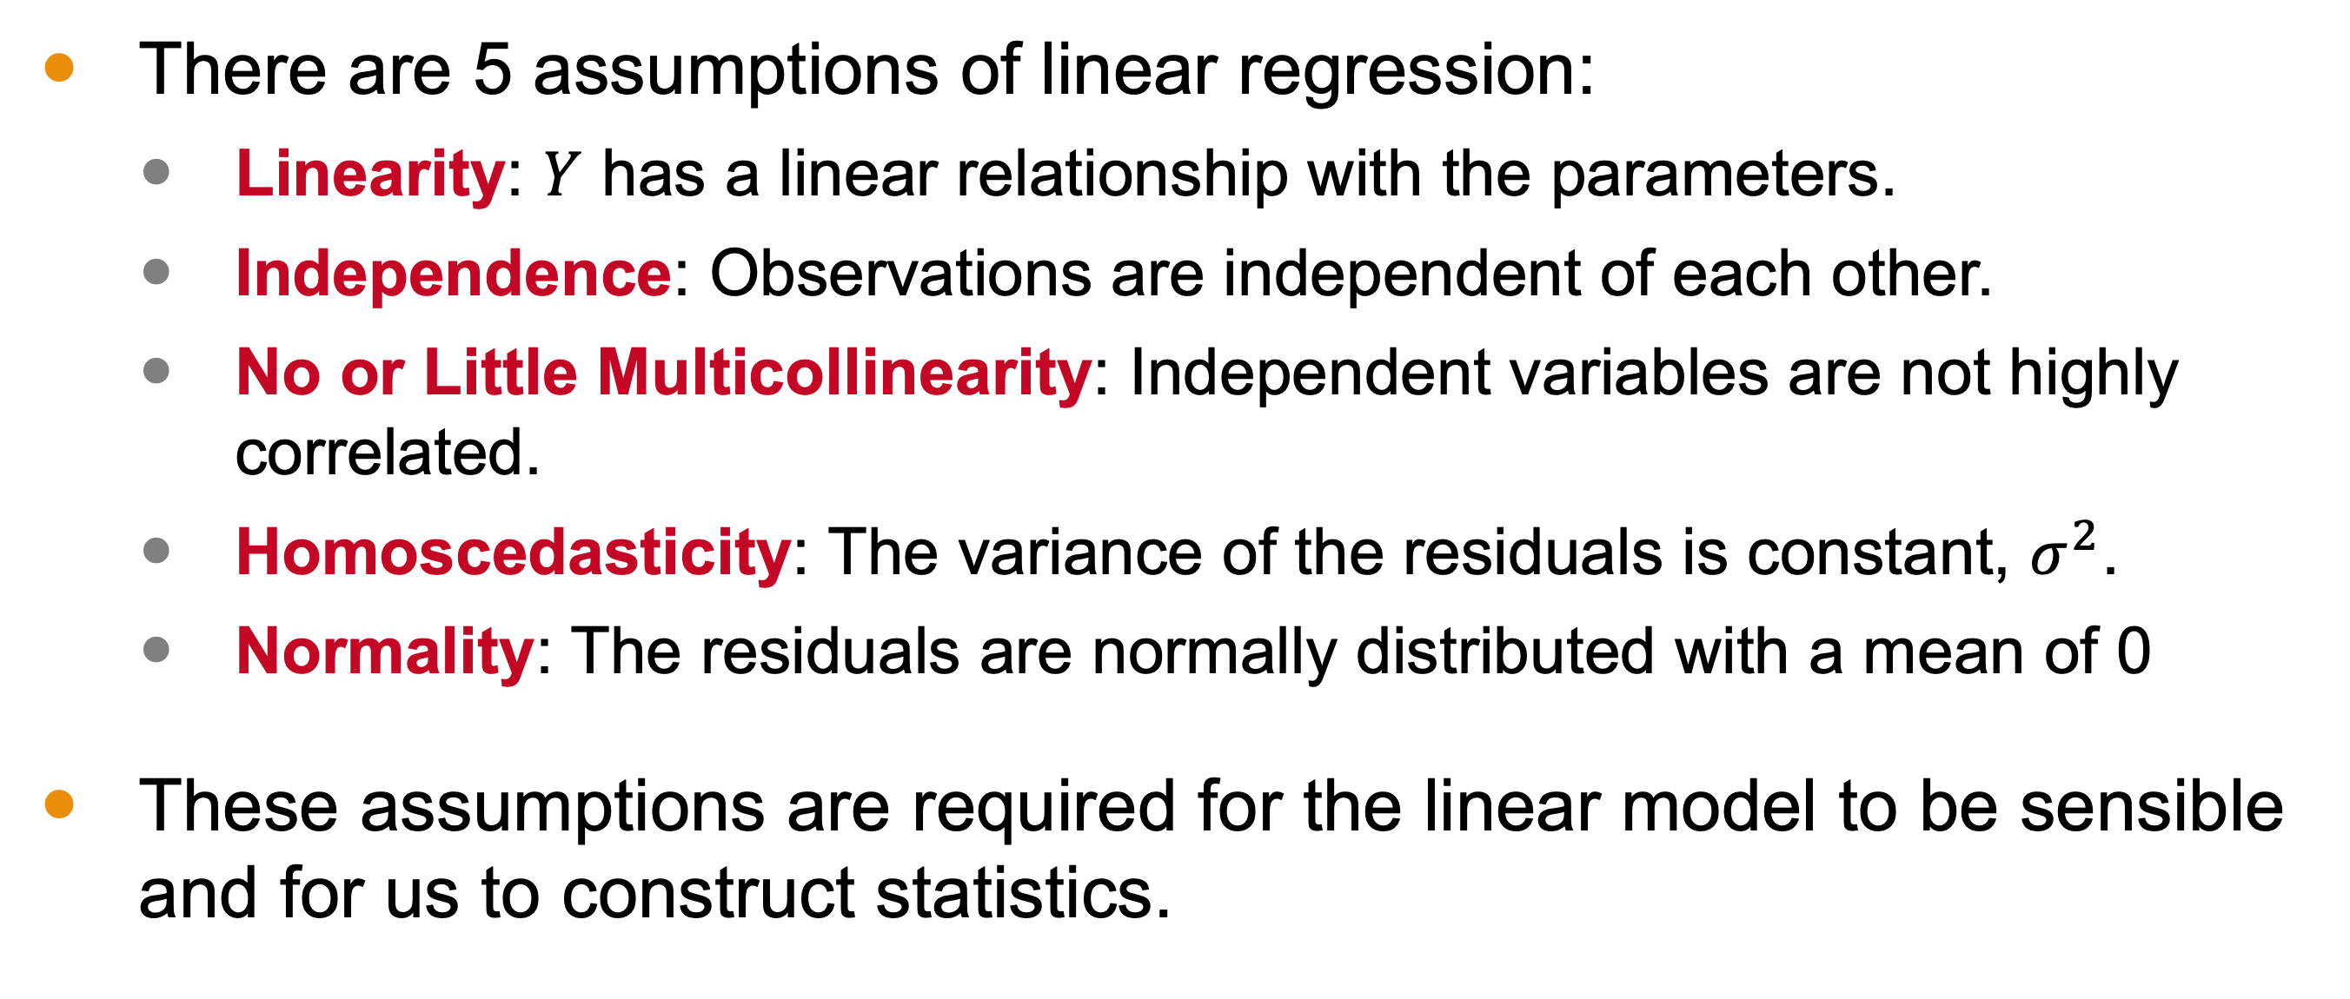
Conclusion
There are 5 assumptions of linear regression:
Linearity: $Y$ has a linear relationship with the parameters.
Independence: Observations are independent of each other.
No or Little Multicollinearity: Independent variables are not highly correlated.
Homoscedasticity: The variance of the residuals is constant, $σ^{2}$.
Normality: The residuals are normally distributed with a mean of 0
These assumptions are required for the linear model to be sensible and for us to construct statistics.

